Slide 1

CALORIE BURNT PREDICTION
USING MACHINE LEARNING

Slide 2
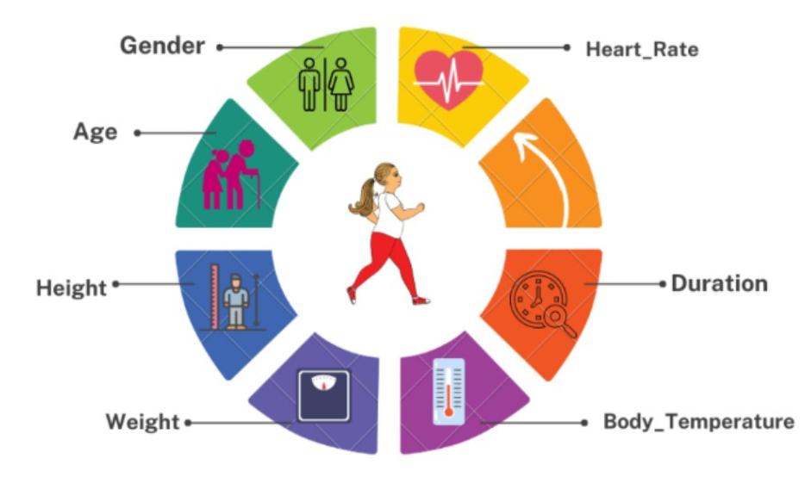
INTRODUCTION
The goal of this project is to predict the number of calories an individual burns during physical activity. Accurate calorie burn predictions are important for the fitness industry. They can make fitness programs and services more effective, help people plan their diet and exercise better, and allow fitness professionals and health professionals to monitor and advice their clients/patients. With this data, fitness businesses can create personalized training plans, improve client satisfaction, and use their resources more efficiently.
The dataset consists of 15,000 records with 7 features.
DATASET TAKEN FROM KAGGLE : https://www.kaggle.com/datasets/sparkyxt/calories-burning-dataset

Slide 3
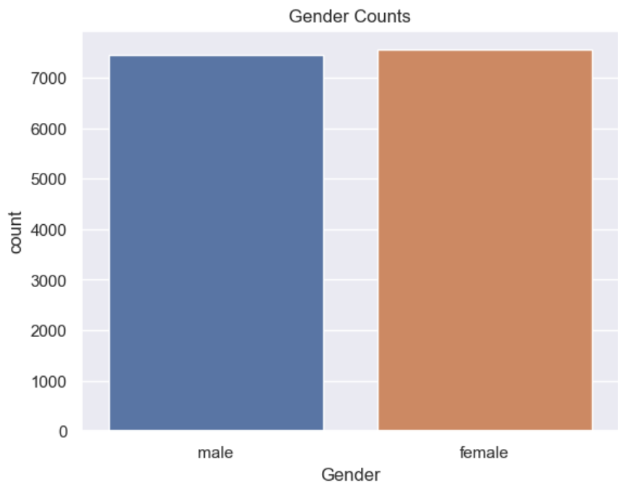
The bar chart represents the gender distribution in the dataset. There is a nearly equal number of records for both genders, which is important for ensuring that the machine learning models do not have gender bias in their calorie burn predictions.
DATA VISUALIZATION

Slide 4
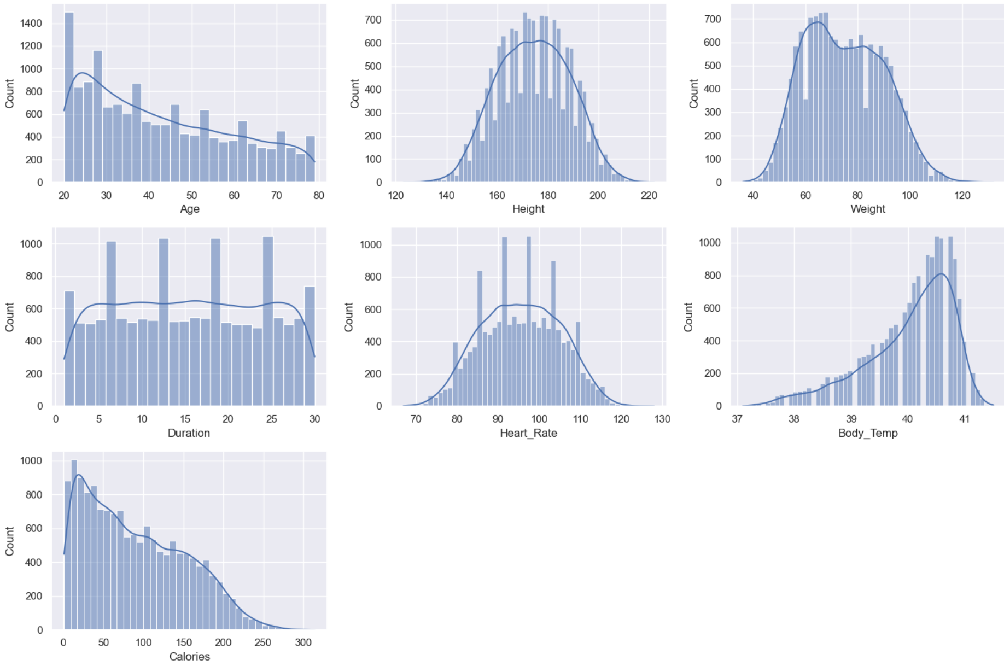
From these distributions, We can infer that Normally Distributed: Height and Heart Rate. Positively Skewed: Age and Calories. Negatively Skewed: Body Temperature.

Slide 5
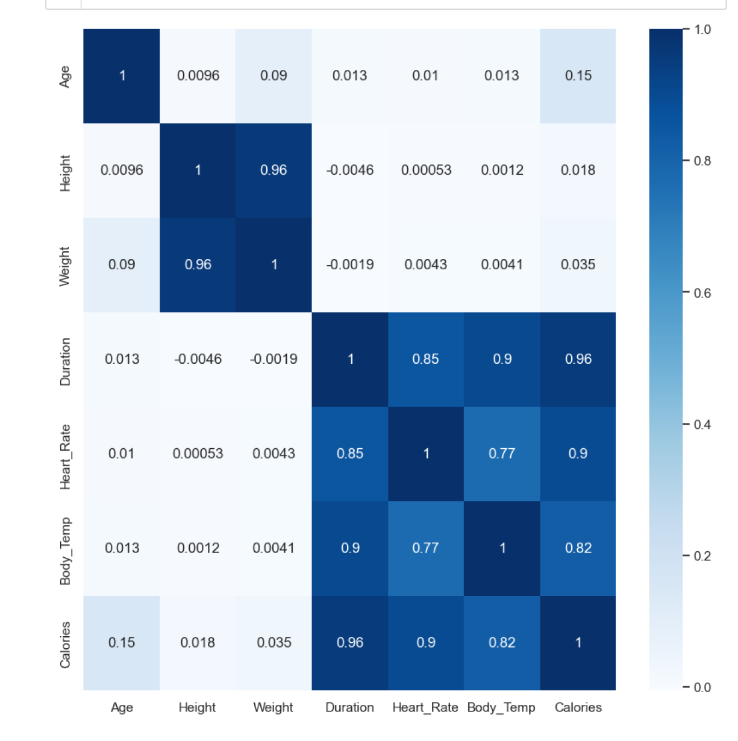
Heatmap visualizes the correlation matrix of the features
• Age: Age has a slight positive correlation with Calories (0.15), indicating that older individuals might burn more calories. However, the correlation is not very strong.
• Height: Height has a very strong positive correlation with Weight (0.96), which is expected as taller individuals tend to weigh more. However, its correlation with Calories is very weak (0.018).
• Weight: Similar to Height, Weight has a very strong positive correlation with Height and a weak correlation with Calories (0.035).
• Duration: Duration has a very strong positive correlation with Calories (0.96), indicating that longer workouts tend to burn more calories. It also has strong positive correlations with Heart_Rate (0.85) and Body_Temp (0.90).
• Heart_Rate: Heart_Rate has strong positive correlations with Duration, Body_Temp, and Calories, with the strongest being with Calories (0.89).
• Body_Temp: Body_Temp has a strong positive correlation with Calories (0.82), indicating that workouts that result in higher body temperatures tend to burn more calories.

Slide 6
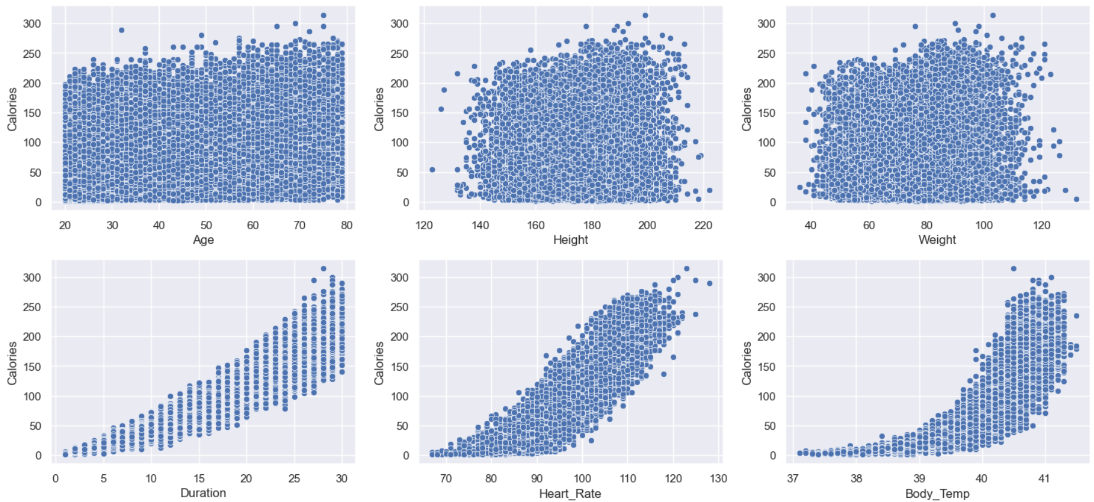
Scatter plots that represent the relationship between ‘Calories’ and each of the features.
• Age vs Calories: Shows the relationship between a person’s age and the number of calories they burn.
• Height vs Calories: Shows how a person’s height might influence the number of calories they burn.
• Weight vs Calories: Shows the relationship between a person’s weight and the number of calories they burn.
• Duration vs Calories: Shows the relationship between the duration of a person’s workout and the number of calories they burn.
• Heart_Rate vs Calories: Shows the relationship between a person’s heart rate during a workout and the number of calories they burn.
•Body_Temp vs Calories: Shows the relationship between a person’s body temperature
during a workout and the number of calories they burn.

Slide 7
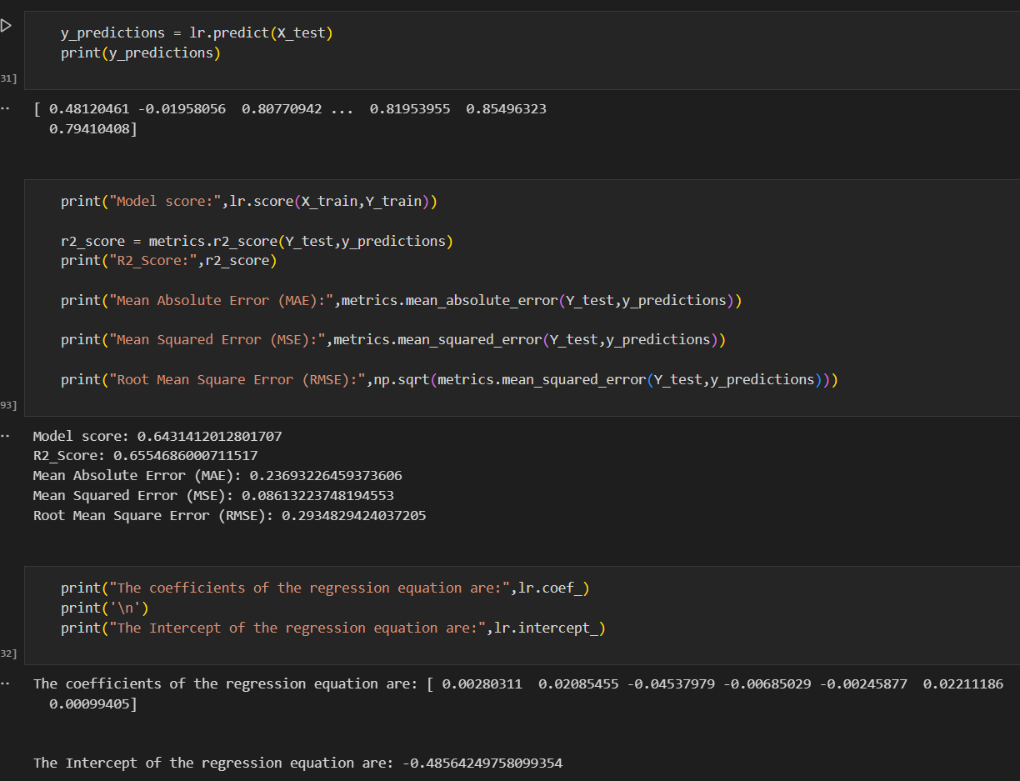
Linear Regression Model
Model Performance:
R² Score (Train): 0.6431 - About 64.31% of the variance in the training data is explained by the model.
R² Score (Test): 0.6555 - About 65.55% of the variance in the test data.
MAE: 0.2369 - Average absolute difference between predicted and actual values.
MSE: 0.0861 - Average squared difference between predicted and actual values.
RMSE: 0.2935 - Square root of the MSE, giving an error measure in the same units as the target variable.
Insights:
Decent performance but limited by a small number of strongly correlated features.
Potential issues with outliers and missing values affecting performance.
Adding more features could improve predictive power.

Slide 8
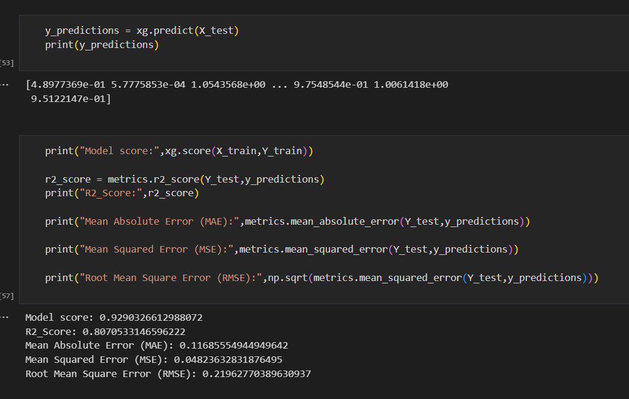
XGBoost Model
Model Performance:
R² Score (Train): 0.9290 - About 92.90% of the variance in the training data.
R² Score (Test): 0.8071 - About 80.71% of the variance in the test data.
MAE: 0.1169 - Average absolute difference between predicted and actual values.
MSE: 0.0482 - Average squared difference between predicted and actual values.
RMSE: 0.2196 - Square root of the MSE, giving an error measure in the same units as the target variable.
Insights:
Superior performance, capturing complex relationships in the data.
Less affected by outliers compared to Linear Regression.
Demonstrates the benefit of using advanced techniques for better predictions.

Slide 9
Model Comparison
XGBoost significantly outperforms Linear Regression in all metrics.
XGBoost's higher R² scores and lower error metrics indicate it captures nonlinear relationships better.
The XGBoost model is more effective for predicting calories burnt during physical activity.
While Linear Regression provides a baseline, it fails to capture complex patterns in the data.
Implications: The results suggest using more sophisticated models like XGBoost for better accuracy in
predictions.
CONCLUSION:
This project not only advances our understanding of calorie burn prediction but also offers practical tools and insights that can revolutionize the fitness industry. By continuing to explore and implement these findings, fitness businesses can provide more personalized, effective, and engaging services, ultimately helping clients achieve their health and fitness goals more efficiently.

Slide 10
Future Work
Explore additional features such as the type of physical activity that has relationship with calorie burn.
Further tune model hyperparameters for better performance.
Implement cross-validation for a more robust evaluation of model performance.
Exploring different models could lead to even better results.

Slide 11
THANK YOU
FITNESS APP
Presented by,
Abdul Quader Mohammed
Deepti More
Sudharsan Tirumal

